Slide 1

Department of ECE
ANALOG ELECTRONIC CIRCUIT DESIGN 22EC2104A
CO-2
Session-5 metal oxide semiconductor field effect transistor (MOSFET): – depletion mode

Slide 2





AIM OF THE SESSION
To familiarize students with the MOSFET Construction and operation in depletion mode
INSTRUCTIONAL OBJECTIVES
This Session is designed to:
Give introduction construction of depletion MOSFET
To analysis operation of MOSFET in depletion mode
LEARNING OUTCOMES
At the end of this session, you should be able to:
1. Describe the working principle of depletion MOSFET.
2. Demonstrate the operation of depletion MOSFET.

Slide 3
INTRODUCTION
A depletion mode MOSFET is a type of MOSFET that operates in a normally on state. It requires a zero or negative gate voltage to create a conductive channel between the source and drain terminals.
In the absence of a gate voltage, current flows between the source and drain. Applying a negative gate voltage depletes the channel, reducing or blocking the current flow.
Depletion mode MOSFETs offer advantages such as simplicity, high linearity, and suitability for analog applications.
They are commonly used in amplifier circuits, voltage regulators, and other applications where precise control of current flow is required.

Slide 4
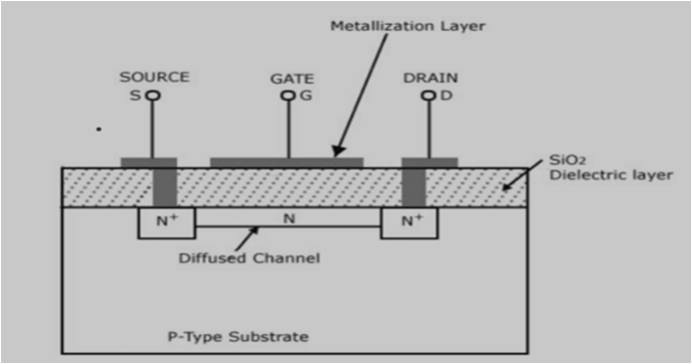
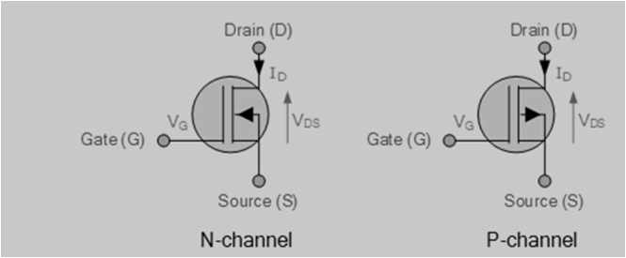
Depletion MOSFET
N channel depletion MOSFET is a 3 terminal device similar to N channel enhancement MOSFET.
The only difference between the two is the existence of an N-channel.
In N-channel depletion MOSFET, N-channel is already present. All other things are the same, as you can see in the figure below

Slide 5
N Channel depletion MOSFET – Working
Working of N channel depletion MOSFET followed by the VI characteristics.
Since the channel is already present, unlike the enhancement type MOSFET, you also will get drain current at zero gate voltage.
In our first case, let us connect the Gate terminal to the ground and apply a positive voltage at the drain and source.
On applying positive V_{DS}, the electrons in the N channel will move towards the positive drain terminal, and the drain current will start flowing from drain to source.
On increasing V_{DS} further, keeping V_{GS} 0, a time will come where I_{D} will become constant, and that value of drain current is called saturation current.

Slide 6
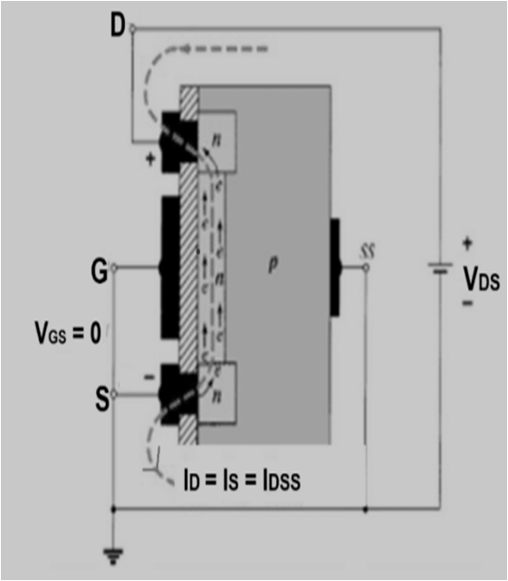
Cont…
We can conclude from this discussion that when V_{GS} = 0 and V_{DS} > 0, current I_{D} flows from drain to source, and on increasing V_{DS} further, I_{D} = I_{S} = I_{DSS}, as shown in the figure below.

Slide 7
Cont…
The effect of gate voltage on N channel depletion MOSFET
Apply V_{GS} < 0. Holes from the P-type substrate will attract towards the negative gate terminal and recombine with electrons in the N channel, forming electron-hole pairs.
On increasing negative potential at the gate, more electron-hole combinations will occur, decreasing the number of free electrons in the N channel.
As a result, I_{D} decreases. A time will come when the drain current will become zero. The negative gate voltage at which the drain current is zero is called pinch-off voltage or VP.
We can conclude from this discussion at pinch-off, V_{GS} = V_{P}, V_{DS} > 0, and I_{D} = 0, as shown in the figure below.

Slide 8
Cont…
On applying VGS > 0, the minority carriers in the p-type substrate, i.e. electrons, will get attracted towards the gate terminal, thereby increasing the concentration of electrons in the N-channel.
As a result, the drain current will increase and exceed the saturation current. We can conclude from this discussion, when VGS > 0 and VDS > 0, then ID > IDSS, as shown in the figure below.

Slide 9
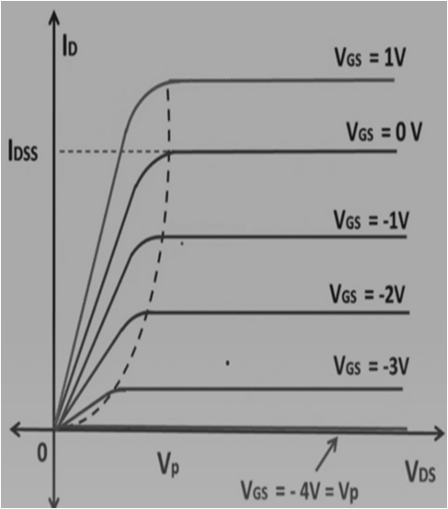
N Channel depletion MOSFET V-I characteristics
Depletion-type MOSFET worked for both positive and negative gate voltages. Now we can plot VI characteristics very easily. In the VI characteristics, you will see the plots of VDS vs ID for various values of VGS.
The graph shows that the current ID will flow for both positive and negative values of VGS.
We can see from the graph that the drain current is less than the saturation current for the negative value of gate voltage, whereas for the positive value of gate voltage, the drain current exceeds the saturation current. V_{GS} = V_{P} is also represented in this graph for which drain current is zero irrespective of drain to source voltage.

Slide 10

SUMMARY
A depletion mode MOSFET is a type of MOSFET that operates in a normally on state. It does not require a gate voltage to create a conductive channel between the source and drain terminals.
In the absence of a gate voltage, current flows freely. However, applying a negative gate voltage depletes the channel, reducing or blocking the current flow.
Depletion mode MOSFETs are known for their simplicity, high linearity, and suitability for analog applications.
They are commonly used in amplifier circuits, voltage regulators, and other applications where precise control of current flow is required, making them valuable components in electronic systems.

Slide 11
SELF-ASSESSMENT QUESTIONS
1. The drain current in an enhancement mode MOSFET is maximum when the gate voltage is:
a) Above the threshold voltage
b) Below the threshold voltage
c) Equal to the threshold voltage
d) Can be above or below the threshold voltage
2. The output voltage swing of an enhancement mode MOSFET is typically limited by:
a) Drain current
b) Gate voltage
c) Drain voltage
d) Source resistance

Slide 12
TERMINAL QUESTIONS
Explain about depletion mode operation of MOSFET?
Draw the characteristics of depletion mode MOSFETS?

Slide 13
REFERENCES FOR FURTHER LEARNING OF THE SESSION
Reference Books:
1. Jacob Millman - “Electronic Devices and Circuits”, 4th Edition, McGraw Hill Education (2015)
2. D Roy Choudhury and Shail B. Jain – “Linear Integrated Circuits”, 4th Edition, New Age International Pvt.Ltd. (2017)
3. David A. Bell - “Electronic Devices and Circuits”, 5th Edition, Oxford University Press (2008)
Sites and Web links:
https://www.learnelectronicswithme.com/2020/07/what-is-jfet-construction-and-working.html
https://electronicspost.com/explain-the-construction-and-working-of-a-jfet-what-is-the-difference-between-a-jfet-and-a-bjt/
https://electronicsdesk.com/junction-field-effect-transistor.html

Slide 14
THANK YOU
Team – ANALOG ELECTRONIC DEVICES AND CIRCUITS

